Slide 1
EPA Plan for the Federal Certification of Applicators of Restricted Use Pesticides Within Indian Country
Dick Wiechman, EPA region 7
Nebraska Project Officer
Tribal Pesticide Program Manager

Slide 2
EPA Plan Overview
The EPA plan fills a regulatory gap and allows legal RUP applications
State certifications are not valid in Indian country
Will be implemented in areas of Indian country where no other EPA-approved or EPA-implemented plan applies
The federal certificates issued under this EPA plan are not valid outside of the applicable areas of Indian country covered by the EPA plan.

Slide 3
EPA Plan Overview (cont.)
Certification will be based on an underlying certificate from a state or tribe (except some private applicator certificates)
States or tribes who issued the original certificate do not assure compliance in Indian country with the federal certification
Basing on state actions but does not add additional authority to states

Slide 4
Plan Overview (cont.)
EPA will administer routine maintenance activities associated with implementation of this EPA plan and will conduct inspections and take enforcement actions as appropriate.

Slide 5
Other Options for Tribes
Tribes may
Continue to pursue the other available options available under 40 CFR § 171.10
Choose to further restrict or prohibit the use of RUPs in their areas through the implementation of tribal codes, laws, regulations, or other applicable tribal requirements.
Notes:
Other options are a written agreement between a state and tribe or a tribal certification plan. Certain requirements for both of these options.

Slide 6
Plan Details (cont.)
List of applicators who are certified under the plan will be posted on the EPA website
The EPA plan is final and published in the Federal Register on February 6, 2014. For the first 6 months, applicators may apply RUPs under the plan if they submit a complete application form to the relevant Region. After 6 months, applicators must possess a federal certification before applying RUPs in Indian country.

Slide 7
Plan Details
Applicator will only be able to apply in Indian country contiguous to the state or tribe that issued the underlying certificate
Commercial applicator categories will be the same as those in the underlying certificate
Federal certificate will expire at the same time as the underlying certificate; certificate for private applicators using training option will expire after 4 years
Notes:
[Some Regions may want to note M-44/1080 exception]

Slide 8
Applicators
Applicators will need to submit a form to the EPA Regional Office
Commercial applicators
Submit copy of valid state, tribal or federal certification
Private applicators
Submit copy of valid state, tribal or federal certification, OR
Submit documentation of completion of required training

Slide 9
Applicators
Refer to EPA Website for more information
http://www2.epa.gov/pesticide-applicator-certification-indian-country
Submit application forms to:
Pesticide Applicator Certification Coordinator
U.S. Environmental Protection Agency – Region 7
WWPD/TOPE/PEST
11201 Renner Blvd.
Lenexa, KS 66219

Slide 10
Additional Information for Applicators
Additional tribal restrictions and requirements may apply.
Applicators are responsible for complying with applicable federal and tribal laws and policies.
Note for private applicators using the training option: Some states prohibit the sale of RUPs to applicators without a valid state certificate if purchasing from dealers located on state lands.
Before using this option, should check to make sure you can purchase RUPs

Slide 11
Dealers
Dealers in Indian country are required to report (name, contact information) to EPA if they are located in Indian country
60 days after plan is final to comply
Dealers must also keep records of RUP transactions

Slide 12
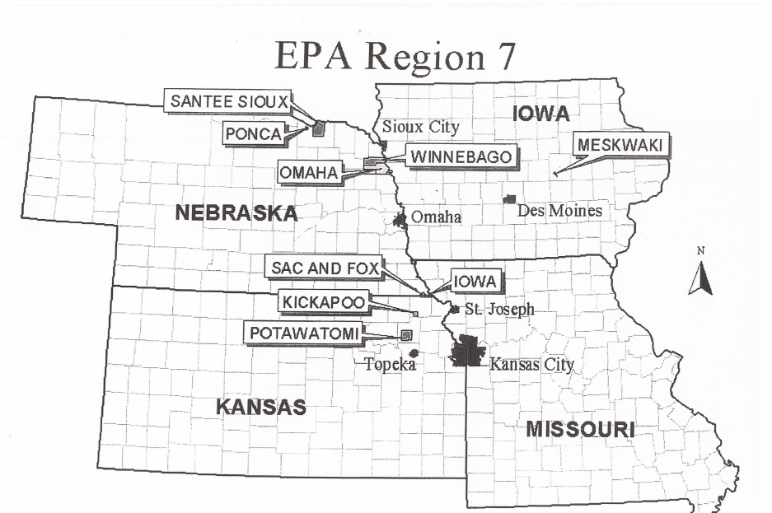
Notes:
Region 7 Tribal Location Map. State certifications are generally not valid in Indian country and certification mechanisms are not in place for most of Indian country (as defined at 18 U.S.C. § 1151). Indian country includes all lands within the exterior boundaries of Indian reservations. EPA Region 7 Tribes that do not have a certification plan or agreement with a State are the Ponca, Meskwaki, Kickapoo, Sac and Fox, Iowa, Omaha, and Winnebago Tribes. Tribes that have an approved certification plan or a certification agreement with a State (such as the Santee Sioux Tribe of Nebraska and the Prairie Band Potawatomi Nation in Region 7) will not be affected by the new Federal Plan. Applicators in all other areas of Indian Country will be required to obtain Federal certification.

Slide 13
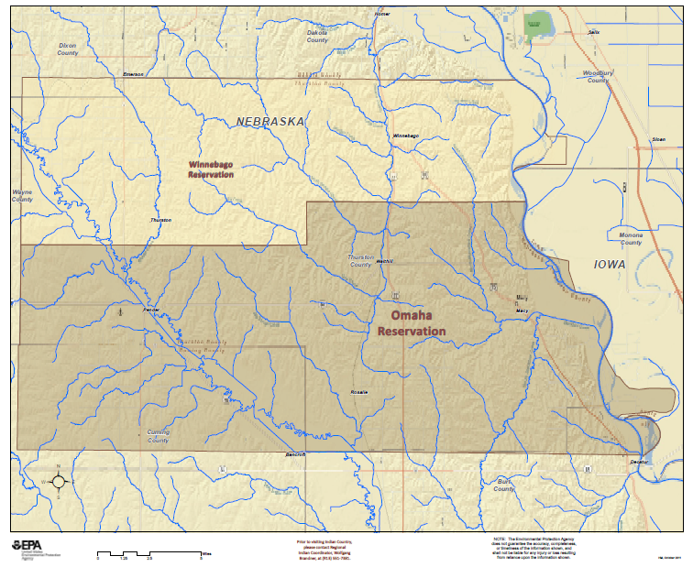
Notes:
EPA Region 7 map showing recognized boundaries for the Omaha and Winnebago Reservations

Slide 14
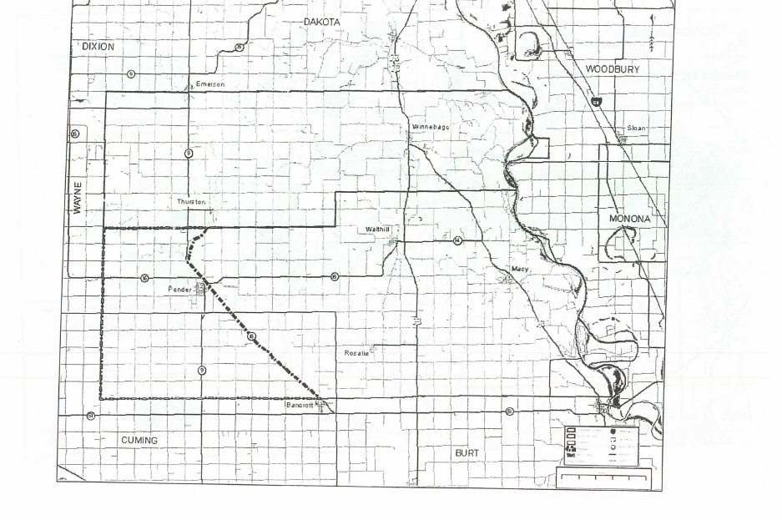
Notes:
Omaha and Winnebago Map showing borders, sections, and roads.

Slide 15
For More Information and Questions
Doug Jones
EPA Region 7 Certification Specialist
jones.doug@epa.gov
913-551-7592
Dick Wiechman, EPA Region 7 Project Officer
Nebraska & Tribal Circuit Rider Pesticide Program
402-437-5080
wiechman.dick@epa.gov

