Slide 1
Pesticide Education The last part!
Jan Hygnstrom
UNL Extension
Pesticide Safety Education Program

Slide 2
There may be an alternative to using a pesticide.
Notes:
Pesticides may not and should not even be your first consideration if you have a pest problem. Can anyone tell me what is going on in this photo? There is a ladybeetle larva eating aphids – biological control. This is one thing to consider with biological control. Sometimes there is a large lag- too long of a lag for the predator to get the prey population under control.

Slide 3
IPM is
An effective and environmentally sensitive approach to pest management that uses all appropriate pest management options
Notes:
In Nebraska, we also consider the economics of pest control or what would happen if there weren’t pest control. Losing the crop isn’t really a viable option, and if avoiding chemical use will cost you the crop, that’s not feasible. We will be going over each element of IPM.

Slide 4
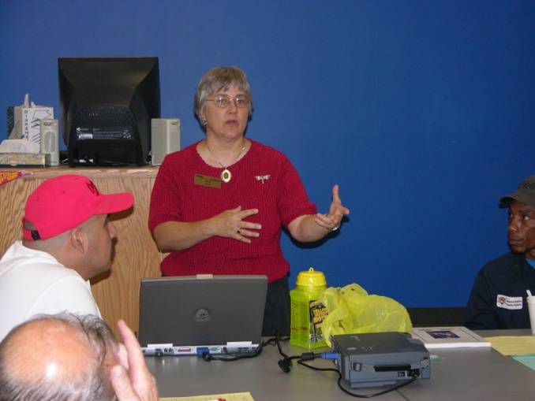
IPM includes education.
Notes:
Here, Barb Ogg is explaining IPM concepts to school facility managers. To use IPM effectively, we have to be able to identify and understand the pest, as well as the crop or whatever it is we are trying to protect.

Slide 5
Newest Noxious Weeds
Japanese Knotweed X Giant Knotweed = Bohemian Knotweed

Slide 6
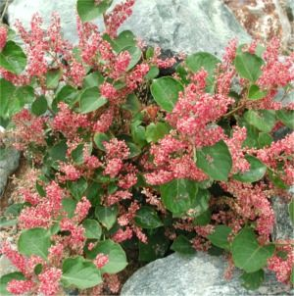
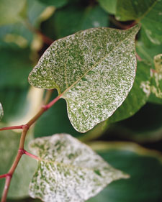
Sold in Nebraska last year
Plant pathogens
Vertebrates
Arthropods
Other invertebrates
Pink Fleece Flower Variegated Fleece Flower
Notes:
These are different cultivars of the knotweed that were sold last year in Nebraska. They’re trying a different approach, by trying to prevent its spread, rather than try to get rid of it once it has become established.

Slide 7
IPM includes habitat modification.
Sanitation
Exclusion
Mechanical Controls
Biological Controls
Chemical Controls
Notes:
Habitat modification here is fixing a leak so that you don’t have high relative humidity. It might be getting rid of tall grasses next to a garden so there is better air flow.

Slide 8
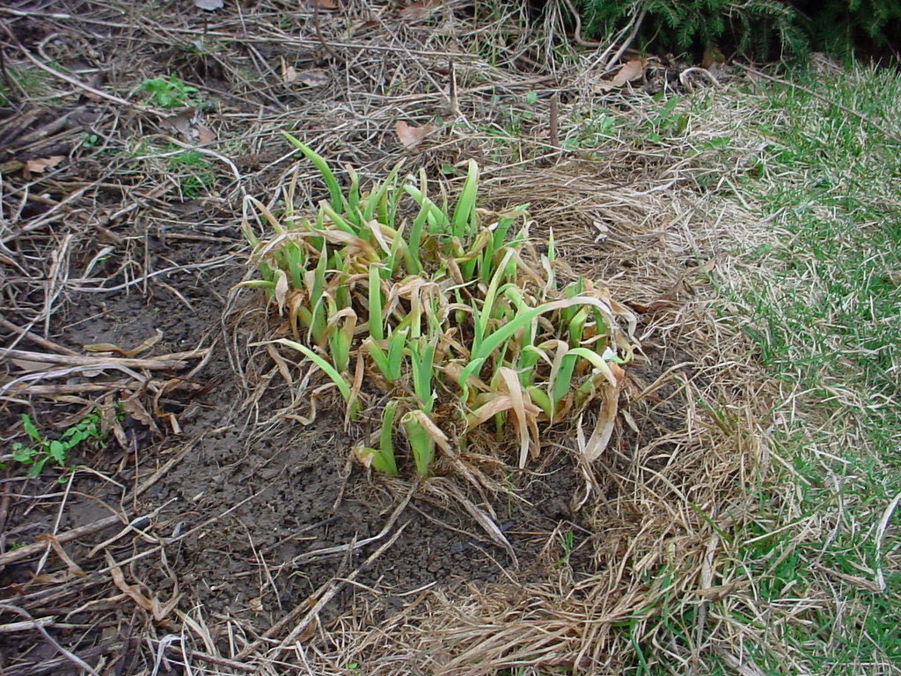
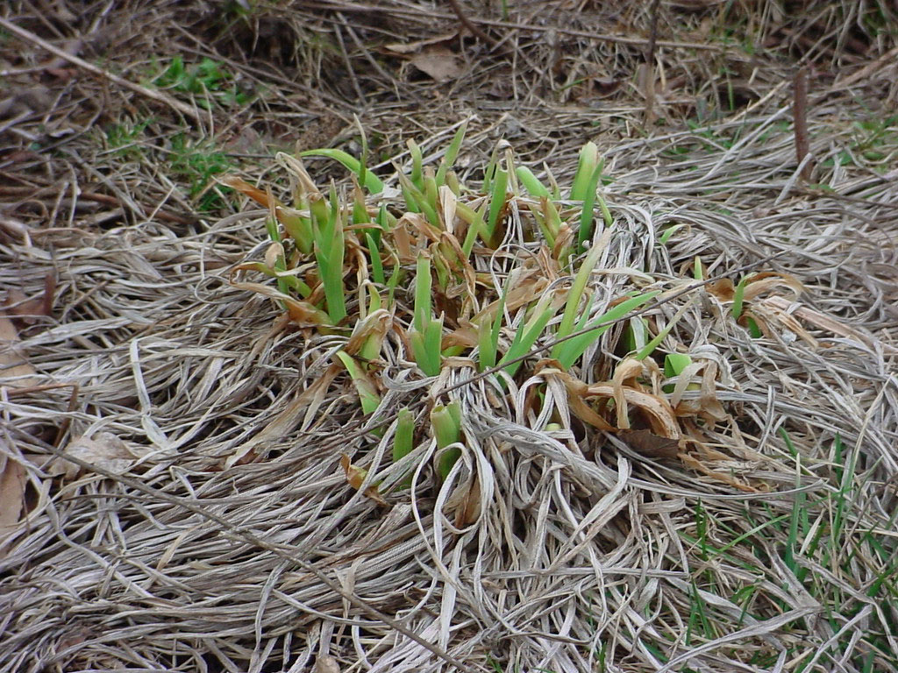
IPM includes sanitation.
Notes:
By getting rid of old leaves, you’re getting rid of areas that might harbor insects or disease organisms.

Slide 9
IPM includes exclusion.
Notes:
Sometimes your best bet to reduce pest problems is to put a fence around the plant or the area to keep the pest out. This often is to keep out larger pests, like rabbits or deer. Does anyone put a collar around plants to keep out some beetles or cutworms?

Slide 10
IPM includes mechanical controls.
Notes:
Sometimes we may have to use traps, like snap traps for mice, or even beer traps to get slugs or snails.

Slide 11
IPM includes biological controls.
Notes:
Biological controls mean using other organisms, like parasites, insects, or diseases, to keep a population in check. Preying Mantids eat lots of insects, including their own young. Release a bunch of these in your garden and you may end up with just one at the end of the season.
This is a catalpa worm that has wasp larvae feeding on it (a tough way to go). One problem with bio controls is that there may be a big lag time before the pest population is controlled.

Slide 12
IPM includes cultural control
Planting date
Rotate crops
Disease-resistant
Notes:
You may be able to plant or harvest a crop earlier or later to avoid the pest. By rotating crops, you’ll reduce disease build-up in the soil, or insect pests.
And planting disease-resistant varieties of plants goes a long way.

Slide 13
IPM includes chemical controls.
Notes:
When I started with IPM in Wisconsin, we recommended judicious use of pesticides, wise and informed use. I mentioned that in Nebraska, economics is part of the equation. Chemical control remains an option, losing the crop isn’t one that we promote.

Slide 14
Pesticides are tools, not miracle workers or silver bullets.
Pesticides cannot correct mistakes made in plant selection, planting, or maintenance.

Slide 15
IPM Process
Monitor
Educate
Accurate ID
Pest level threshhold
Evaluate
Select control
Notes:
Monitor for pests
Sticky traps, visual inspections
Accurate identification of pests
Education, appropriate reference materials
Determine pest levels that trigger action
Selection of control tactics
Choose non-toxic or lower toxicity pesticides
Use hand picking instead of dust for hornworms
Evaluate effectiveness of tactics
Keep accurate records, on-going monitoring for pests, adjust as indicated
Educate everyone involved

Slide 16
IPM is
Effective and environmentally sensitive approach to pest management that uses all appropriate pest management options

Slide 17
Question
As a Master Gardener, what is a question you've been asked, or a situation you've dealt with that involved pesticides?
Notes:
As a Master Gardener, what is a question you've been asked, or a situation you've dealt with that involved pesticides? If your first response is how much of a pesticide is used, make note of that and think of something else. If you are new to being a Master Gardener, write down an issue or situation that you experienced and wish you had a Master Gardener offer help/suggestions.
I’ll give you an example. I was cleaning out an old storage area, and found a metal can with about 1/3 cup of 2,4-D in it. The can was rusted. What should I do with all of this?
Write down the situation. (Give them about 5 minutes, and watch to see if they are finished prior to that, or if they need more time).

Slide 18
Get into groups and pick 1 to present to all of us for discussion.
Notes:
Next, have the MGs get into groups of 4 and talk about their questions, but not how they responded. Have each group pick out one to present to the entire class that they find exceptionally interesting, or that we might be able to learn from or discuss. Select a speaker who will read/say it to the class. (This may take about 15 minutes).
I will wander around and encourage them to not dwell on each at this time.

Slide 19
Each group present a question/issue.
Notes:
Have each group present a question/response. We will list all of them and refrain from comment. After all are listed, depending on time, we will pick on or two to discuss. If there is time, maybe all. We'll look at the question, the response, and see how others felt about the response. Would they have responded the same way? Did the "solution" incorporate IPM strategies, or pesticide safety?

Slide 20
Let’s talk about a few.

Slide 21
Additional questions
Do you talk about IPM or incorporate it into your sessions? How?

