Slide 1
Pesticide Education
Jan Hygnstrom
Pesticide Safety Education Program

Slide 2
What do you do or hope to do as a Master Gardener?
Notes:
Take a minute and jot down what you do or hope to do. Then, I’d like to hear what you will be doing. I mentioned that I answered questions via phone calls.

Slide 3
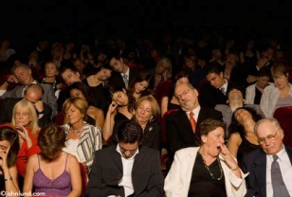
My challenge is to keep your attention.
Notes:
How many of you are new to the Master Gardener program? How many of you have heard about IPM before? My challenge, besides keeping your attention, is to help you discover something new, refresh a forgotten memory, or make something click. There is a great deal of experience in this room, and I want to use that experience. I’m going to ask you to share ideas, questions, so we aren’t just looking at PowerPoints for 3 hours! And I intend to learn from you.

Slide 4
We will not cover selecting the right pesticide or the right dose.
Hope
Biocide
Bleach
Fumigant
Herbicide
Fungicide
Insecticide
Notes:
I don’t know what pesticide to use for a particular pest, nor do I know the right dose. Instead, I hope we can work together to refresh our memories or learn something new about IPM, and how to get that message to the public.

Slide 5
We will talk about risk.
Notes:
Risk is the potential for something, usually bad, to happen. How we handle pesticides can reduce risk of something bad happening.

Slide 6
We will talk about IPM and safety.
IPM
UNL Extension
Pesticide Safety Education Program
Notes:
We’re also going to talk about Integrated Pest Management, to refresh our memories, and share ideas. I’d like us to think about IPM when we work with the public, not only to talk about IPM and safety, but to demonstrate it in our actions.

Slide 7
Is there really a need for pesticide safety education?
Notes:
I think that we take pesticides too lightly. Often, they’re packaged in pretty boxes, which maybe hides the fact that they can cause serious injury and death. I’m going to share some incidents for us to think about and talk about.

Slide 8
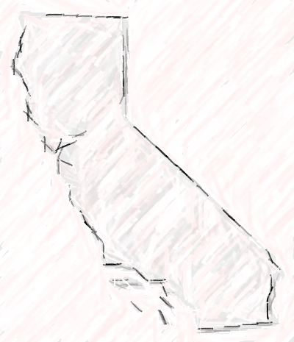
Top 10 Pesticide Blunders
California
Notes:
You might say, “Yes, but that’s California.” I think that some of these have happened throughout the US. Grab a piece of paper, and jot down ideas that come to your head as I tell of the big 10.

Slide 9
1. An older child sprayed an infant with pesticide.
Notes:
-Mother hears laughter, found baby’s face shiny-wet
-Baby bathed and taken for medical care
-Emphasizes need for proper storage

Slide 10
Why did this happen?

Slide 11
2. Resident applied aluminum phosphide pellets to a squirrel hole next to garage, then added water.
Notes:
-Later noticed strong odor
-Family evacuated, stayed away for 6 days
-Product can explode, start fires, or kill someone
-Similar incident occurred in Nebraska
-Aluminum phosphide put into bucket of water, dumped into storm sewer, exploded

Slide 12
Why did this happen?

Slide 13
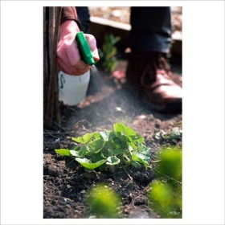
3. A man drank alcohol while spraying a pesticide on plants in his yard on a hot day.
Notes:
-Mistakenly drank pesticide from measuring cup
-Spat out, vomited, could not explain why Ready-to-Use (RTU) in cup

Slide 14
Why did this happen?

Slide 15
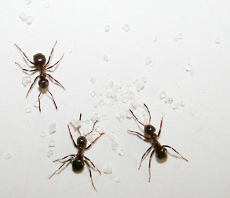
4. A man went to shower and saw ants in the bathroom.
Notes:
He set off a bug bomb, stayed in the shower, and had symptoms.

Slide 16
Why did this happen?

Slide 17
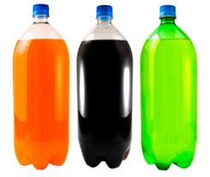
5. Late at night a woman found and drank from a soft drink bottle in her shed.
Notes:
- It tasted bad, thought it had “gone bad”, had symptoms
- Daughter told her that gardener friend gave weed killer
- It was labeled “grass killer,” not obvious in dark

Slide 18
Why did this happen?

Slide 19
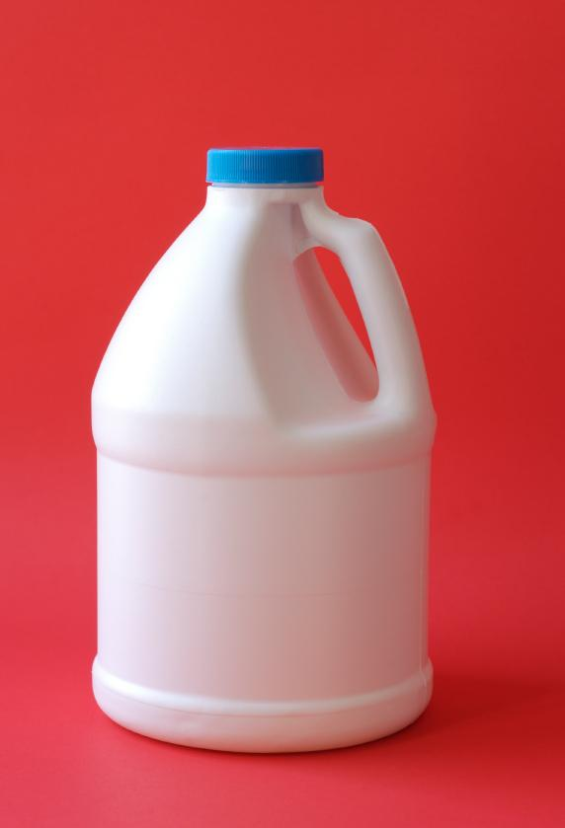
6. A man wanted to borrow bleach, and the neighbor offered the whole bottle.
Notes:
-Man insisted on pouring into water bottle
-Man took phone call and hurriedly left, leaving bottle
-3-year old had habit of grabbing & drinking from bottles
-Child drank from bottle, vomited, taken to hospital

Slide 20
Why did this happen?

Slide 21
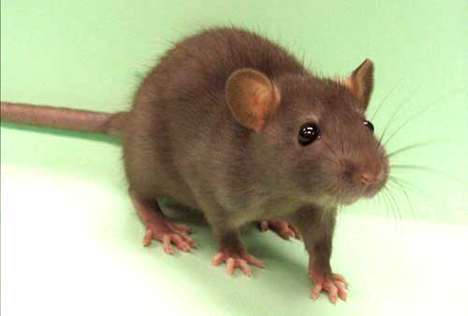
7. A man bought a granular insecticide to kill rats.
Notes:
-Planned to mix with water, when opened it got on face
-He developed symptoms, tried to induce vomiting with possibly contaminated finger, symptoms got worse
-Wife took him for medical treatment

Slide 22
Why did this happen?

Slide 23
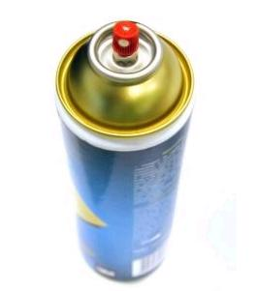
8. A resident didn’t read the label on an aerosol insecticide.
Notes:
Stood on stool to spray up into the air towards ants 3-4 feet away, got sick a few hours later
Product label directs to hold can 1-foot from surface, and not to spray into the air

Slide 24
Why did this happen?

Slide 25
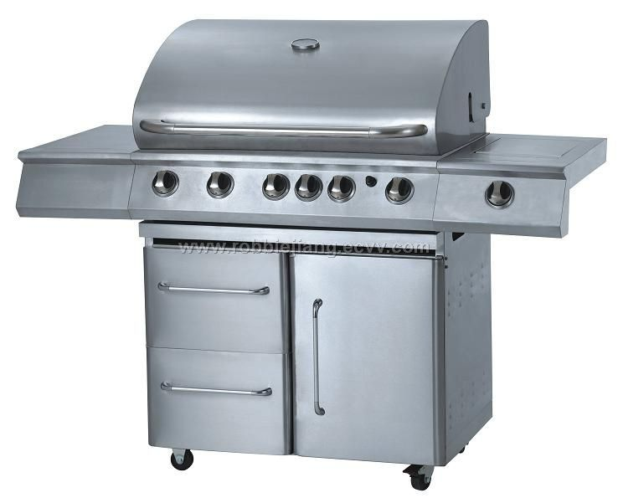
9. A man sprayed his barbecue grill heavily for ants.
Notes:
That evening, used barbecue to cook hamburgers
He felt sick minutes after eating hamburger
Sought care after vomiting all night
Insecticide label requires food handling equipment to be protected from contamination

Slide 26
Why did this happen?

Slide 27
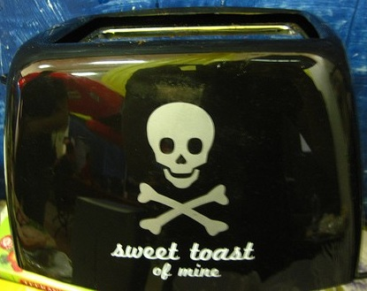
10. A man took a bathroom break while spraying for ants.
Notes:
Thought he left sprayer inoperable
Wife found their 2-year old spraying the toaster
Child washed, toaster was toast
Child vomited, went to see the doctor

Slide 28
Why did this happen?

Slide 29
What can we learn from these?
Notes:
Some items bear repeating… again and again and again.
Always read the label
Never leave pesticides unattended
Keep pesticides in original containers
Keep information on poison control center/hospital handy

Slide 30
What can we learn from these?
Always read the label
Notes:
Some items bear repeating… again and again and again.
Always read the label
Never leave pesticides unattended
Keep pesticides in original containers
Keep information on poison control center/hospital handy

Slide 31
What can we learn from these?
Always read the label
Never leave pesticides unattended
Notes:
Some items bear repeating… again and again and again.
Always read the label
Never leave pesticides unattended
Keep pesticides in original containers
Keep information on poison control center/hospital handy

Slide 32
What can we learn from these?
Always read the label
Never leave pesticides unattended
Keep pesticides in original containers
Notes:
Some items bear repeating… again and again and again.
Always read the label
Never leave pesticides unattended
Keep pesticides in original containers
Keep information on poison control center/hospital handy

Slide 33
What can we learn from these?
Always read the label
Never leave pesticides unattended
Keep pesticides in original containers
Keep information on poison control center/hospital handy
Notes:
Some items bear repeating… again and again and again.
Always read the label
Never leave pesticides unattended
Keep pesticides in original containers
Keep information on poison control center/hospital handy

