Slide 1
We will talk about risk.
Notes:
People don’t consider risk when they buy and use pesticides. I really believe that people take pesticides lightly, too lightly. I’m guilty of that. We’ll cover risk in the next half hour. I think it’s really important that you, as Master Gardeners, can educate about safe use, and especially demonstrate through your actions.

Slide 2
Risk = Toxicity X Exposure
= X
Notes:
We’ll look at this formula a little more closely. Frankly, it is something I haven’t thought about, and I need to make it automatic.
Risk is the potential or probability that something bad will happen. We’ll talk about the interplay between Toxicity and Exposure when thinking about pesticides.

Slide 3
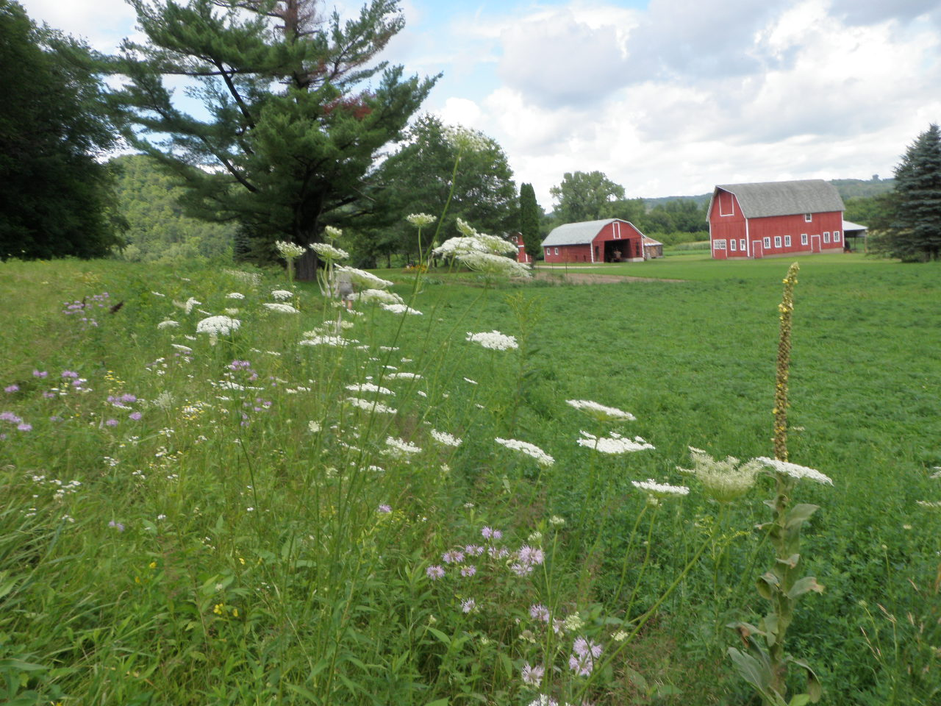
Should we be concerned with pesticides?
Ag Health Safety
Notes:
First, should we be concerned with pesticides and pesticide use? I think the previous items we talked about shows that we should.

Slide 4
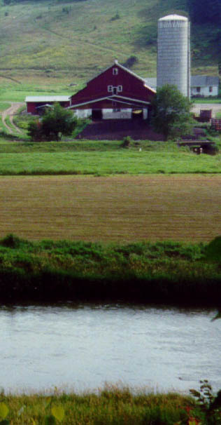
Glyphosate; 2,4-D; & chlorpyrifos residues have been found in farm homes.
Notes:
Glyphosate; 2,4-D; & Chlorpyrifos residues found in farm homes. Chlorpyrifos is an organophosphate that has been sold under the trade names of Lorsban and Dursban. It was a well-known home and garden insecticide, and at one time one of the most widely used household pesticides in the US. It is moderately toxic and chronic exposure has been linked to neurological effects, developmental disorders, and autoimmune disorders. Facing impending regulatory action by the EPA, Dow agreed to withdraw registration of chlorpyrifos for use in homes and other places where children could be exposed, and severely restricted its use on crops. These changes took effect on Dec. 31, 2001.^{[8]} It is still widely used in agriculture, and Dow continues to market Dursban for home use in developing countries.
If true for AG chemical, is it true for lawn & garden pesticides, structural insecticides, rodenticides?

Slide 5
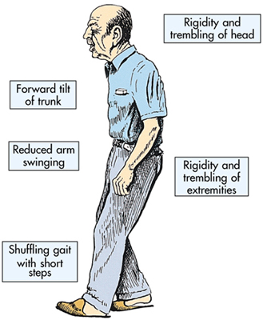
There is a relationship between Rotenone and Parkinson’s Disease.
Notes:
The Ag Health Study has shown that there is a relationship between rotenone and PD, although they still need to determine what that relationship is. It may not be a cause and effect relationship.

Slide 6
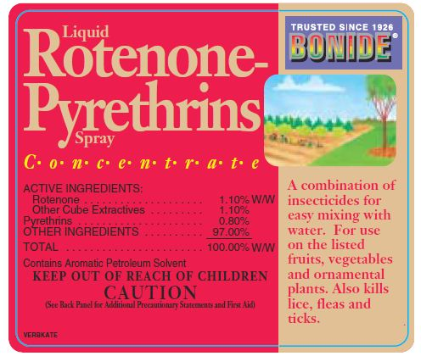
Isn’t rotenone a natural pesticide, and therefore safe?
Notes:
Myth: Organic pesticides are less toxic than synthetic ones
Truth: Misused pesticides can be harmful, regardless of whether they are considered natural or synthetic. Pyrethrum, for example, is made from chrysanthemums but is still toxic to people and pets when handled improperly. Whenever possible, it’s best to select the least toxic control option available because, even if not lethal, many of these pesticides can cause serious health complications. Safe storage of these products can help prevent any harmful accidents. Read and follow all label directions, and remember that these products are tools, not miracle workers or silver bullets. Pesticides cannot correct mistakes made in plant selection, installation, or maintenance.

Slide 7
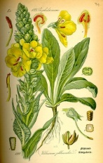
Rotenone is from specific tropical plant roots and stems.
Notes:
Source
Roots, stems of specific plants
Natural or Organic

Slide 8
Rotenone is mildly toxic to mammals
Toxicity
Mildly toxic to mammals
Lowest lethal dose for child is 143 mg/kg
Human deaths rare – causes vomiting
Poorly absorbed by human GI, skin
Notes:
Toxicity
Mildly toxic to mammals
Lowest lethal dose for child is 143 mg/kg
Human deaths rare – causes vomiting
Poorly absorbed by human GI, skin

Slide 9
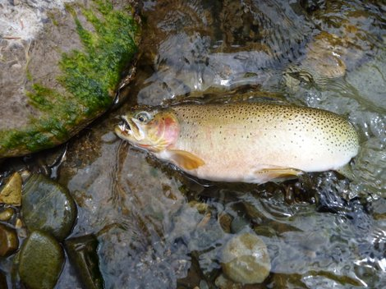
Rotenone is extremely toxic to fish.
Notes:
Toxicity: Rotenone is extremely toxic for fish, insects. It is readily absorbed through gills of fish and trachea of insects.
Indigenous tribes used for fishing – they would sprinkle it on water, and fish would float to the surface. It is now used as a Piscicide to manage fish populations by getting rid of undesirable fish.

Slide 10
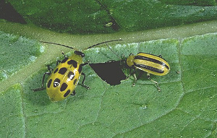
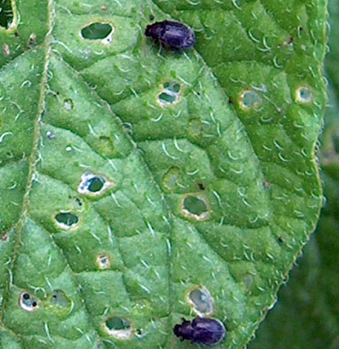
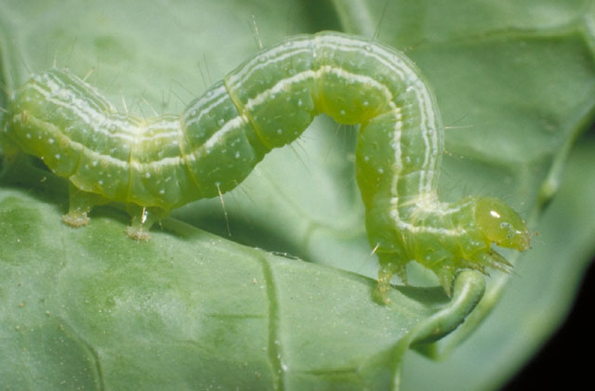
Rotenone was used as an insecticide.
Notes:
Rotenone registrants requested voluntarily cancellation of all livestock, residential, and home owner uses, domestic pet uses, and all other uses except for piscicide uses in 2006. Rotenone is an RUP only allowed for use as a piscicide. Rotenone had registered uses for dust products in agricultural and residential settings which were of particular concern for inhalation exposure. All non-RUP agricultural and residential uses, and all food uses were voluntarily cancelled in 2006.
Dust
Biodegrades in a few days
Colorado potato beetles, cucumber beetles, flea beetles, cabbage worms

Slide 11
Pesticides derived from plants can be just as dangerous as synthetic chemicals.
Notes:
So, remember that natural or organic can be dangerous. I’d especially be carefully of using pesticides brought in from other countries to be sold dirt cheap. They do not always have the inspection processes we do for quality control in the US, and in some cases have inaccurately labeled products.

Slide 12
Toxicity is measured through LD50
Notes:
Lethal dose 50 is the dose that will kill 50% of a population. Rats are often used to test LD50.
Given in mg/kg

Slide 13
Milligrams per Kilogram
1 Milligram = 0.0000352 Ounces
30,000 Milligrams = 1.058 Ounces
1 Kilogram = 2.2 pounds
68.04 Kilograms = 150 Pounds

Slide 14
Milligrams per Kilogram
1 Milligram = 0.0000352 Ounces
30,000 Milligrams = 1.058 Ounces
1 Kilogram = 2.2 pounds
68.04 Kilograms = 150 Pounds
Boric acid, oral LD₅₀ > 10,000 mg/kg
Rotenone, oral LD₅₀ = 132 to 1,500 mg/kg

Slide 15
Arrange these materials in order from least dangerous to most dangerous, using LD₅₀.
Alcohol
Aldicarb (Temik)
Ammonia
Arsenic
Aspirin
Botulinum
Dioxin
Glyphosate
Malathion
Metalaxyl (Ridomil)
Nicotine
Salt
Sugar

Slide 16
Relative Toxicity, Rat (oral LD50 in mg/Kg)
Sugar (sucrose) | 29,700
Alcohol | 14,000
Glyphosate (Roundup) | 5,600 | Caution (low)
Salt (sodium chloride) | 3,000
Malathion | 1,375 | Caution (low)
Aspirin | 1,000
Metalaxyl (Ridomil) | 633 | Warning (mod)
Ammonia | 350
Arsenic (arsenic acid) | 48
Nicotine | 1
Aldicarb (Temik) | 0.93 | Danger - Poison
Dioxin (TCDD) | 0.001
Botulinum toxin | 0.00001
Notes:
First of all, let’s address the nature or toxicity of specific chemicals. This is a list of some common chemicals, both natural and man-made, which have different toxicities. As you can see by the arrows to the left, they range from least toxic at the top to most toxic at the bottom. In the case for each of these chemicals, their relative toxicity is compared in a standard manner based on the oral LD 50 in test rats, which is the dose of the chemical that is required to kill 50% of the rats in a specified amount of time.
You can see from the list that things such as table sugar, ethyl alcohol (the kind found in beer, wine and liquor), and even aspirin, a substance commonly used as a “remedy”, are toxic depending on the amount or dose received.
For some of the common use pesticides such as Roundup, Malathion, Ridomil, and Temik, we have listed for you on the right side of the table the U.S. Environmental Protection Agency’s Signal Word, which corresponds to the level of toxicity for the chemical. The signal words are caution, warning, and danger; caution signifies the least toxic and danger signifies the most toxic. The EPA mandates that the signal word is clearly printed on the pesticide label.

Slide 17
Proper purchase can reduce risk.
Notes:
So what are some ways we can reduce risk? When thinking about toxicity…

Slide 18
Purchase the least toxic pesticide that will do the job.
Notes:
Read the label and check for the signal words of Caution, Warning, and Danger. Which is the least hazardous? Caution.

Slide 19
Read and understand the label.
Notes:
Before purchasing, look at the label to see if it is labeled for the pest and crop.

Slide 20
Purchase the safest formulation.
Notes:
Let’s review formulations.

Slide 21
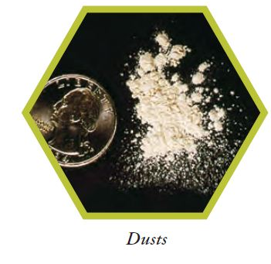
Pesticide formulations include solids.
Notes:
Many solids are ready-to-use dusts, granules, or baits.
Dusts can provide excellent coverage, but the small particle size creates an inhalation and drift hazard.

Slide 22
Pesticide formulations include solids.
Notes:
Granules are applied dry and usually are intended for soil applications where their weight carries them through foliage to the ground below. The larger particle size of granules reduces the chance for drift. There is also a reduced inhalation hazard, but there still may be some fine particles . In addition, granules have a low dermal hazard. Granules also may have to be incorporated into the soil to work. They may be attractive to nontarget organisms such as birds.

Slide 23
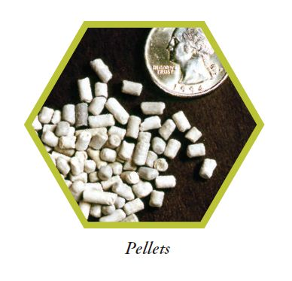
Pesticide formulations include solids.
Notes:
Pellets are typically used in spot applications. Pelleted formulations provide a high degree of safety to the applicator. They do have the potential to roll on steep slopes and thereby harm nontarget vegetation or contaminate surface water.

Slide 24
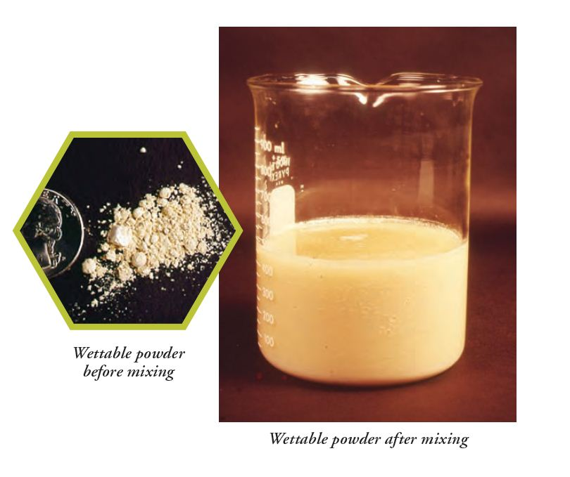
Pesticide formulations include solids added to water.
Notes:
Wettable powders are fine mineral clays, to which an active ingredient is sorbed. It is diluted with water and applied as a liquid spray. Wettable powders pose a lower dermal hazard in comparison to liquid formulations. This formulation can present an inhalation hazard to the applicator during mixing because of the powdery nature of the particles. As they form a suspension, they require agitation to prevent settling out.

Slide 25
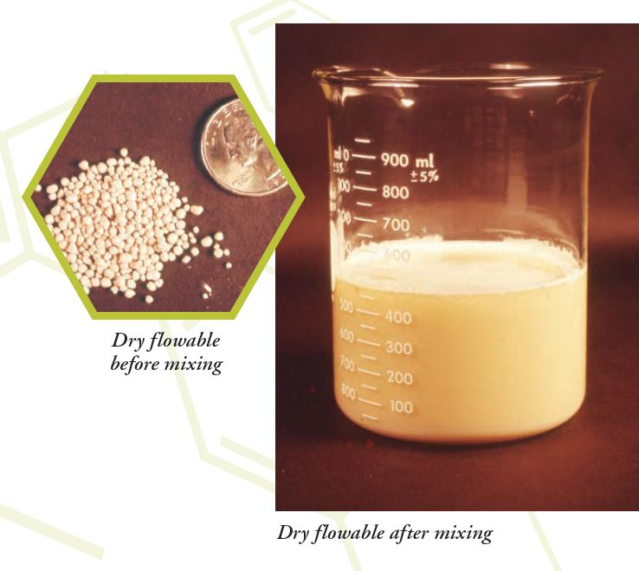
Pesticide formulations include solids added to water.
Notes:
During the mixing process, dry flowables pour more easily from the container and, because of their larger particle size, reduce inhalation hazard to the applicator.

Slide 26
Pesticide formulations include solids added to water.
Notes:
Soluble powders are not common because few solid active ingredients are soluble in water. Those that are formulated as soluble powders are mixed with water in the spray tank, where they dissolve and form a true solution prior to spraying. Soluble powders provide most of the same benefits as wettable powders, without the need for agitation once dissolved in the tank. Soluble powders can present an inhalation hazard to applicators during mixing.

Slide 27
Pesticide formulations include liquids.
Notes:
Liquid flowables are quite like wettable powders except that the powder, dispersing agents, wetting agents, etc., are mixed with water before packaging. The result is a suspension requiring further dilution with water before use. The product is applied as a spray, with all the advantages of a wettable powder. The benefit of this formulation is that there is no inhalation hazard to the applicator during mixing since the powder already is suspended in water, permitting it to be poured.

Slide 28
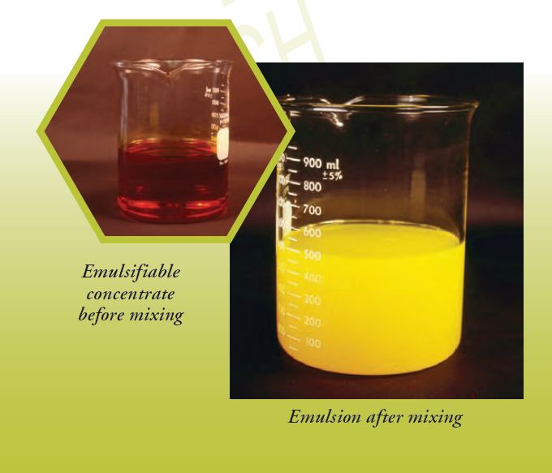
Pesticide formulations include liquids.
Notes:
An emulsifiable concentrate is an oil-soluble active ingredient dissolved in an oil-based solvent, with an emulsifying agent added. This helps keep it mixed when you dilute it with water. Otherwise, it’s like oil and vinegar – they don’t mix. It is applied as a spray. It requires some agitation.
Some disadvantages are: They present a dermal hazard; they can penetrate oily barriers like human skin; they usually have an odor problem; they can burn foliage; and they can cause rubber and plastic equipment parts to break down.

Slide 29
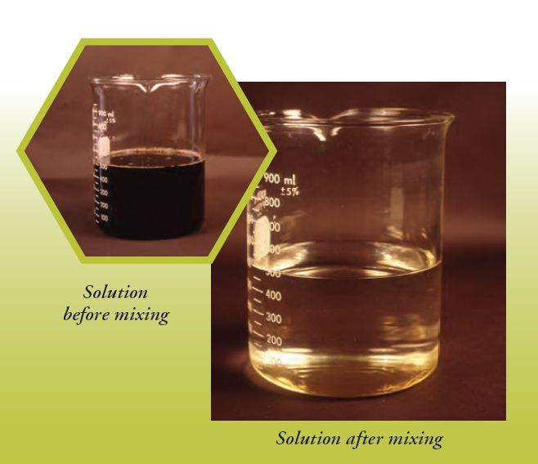
Pesticide formulations include liquids.
Notes:
Solutions (water-soluble concentrates) consist of water-soluble active ingredients dissolved in water. They must be diluted more before use.

Slide 30
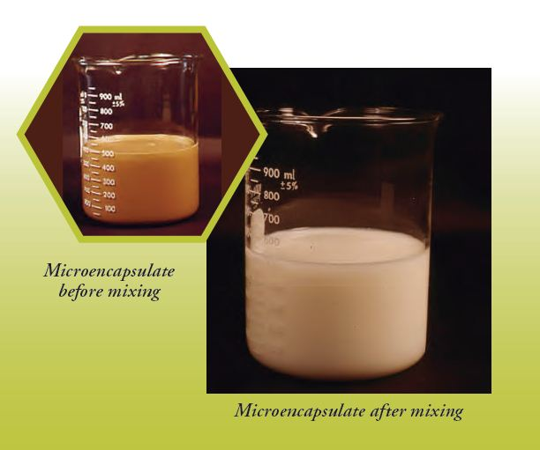
Pesticide formulations include liquids.
Notes:
Microencapsulates consist of a solid or liquid inert (containing an active ingredient) surrounded by a plastic or starch coating. The capsules are sold as dispersible granules (dry flowables), or as a liquid formulation. Encapsulation enhances applicator safety while providing timed release of the active ingredient. Liquid forms of microencapsulates are further diluted with water and applied as sprays.

Slide 31
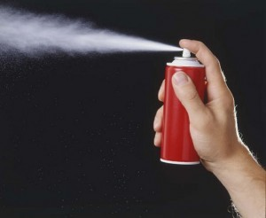
Pesticide formulations include aerosols.
Notes:
Aerosols really refer to a delivery system that moves the active ingredient to the target site in the form of a mist of very small particles: solids or liquid drops. The particles can be released under pressure or produced by fog or smoke generators. Aerosols are especially useful for indoor insect control, as coverage is thorough. But it can be difficult to confine the aerosol to the target area, and there is always the danger of inhalation.

Slide 32
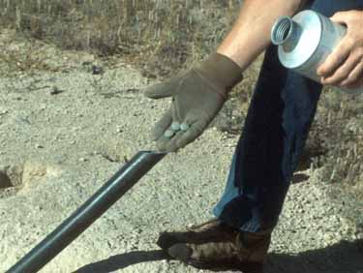
Pesticide formulations include fumigants.
Which is best?
Notes:
Fumigants deliver the active ingredient to the target site in the form of a gas. Fumigants can completely fill a space, and many have tremendous penetrating power. They can be used to treat objects (e.g., furniture), structures, grain, and even soil for pest insects and other vermin. Fumigants are among the most hazardous pesticide products to use due to their inhalation danger.

Slide 33
Best Formulation? Consider
Effectiveness?
Exposure to applicator?
Drift?
Non-target species?
Ease of use?
Application equipment?
Cost?

Slide 34
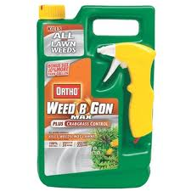
When selecting a pesticide, consider Ready-to-Use.
Notes:
Ready-to-use may be more expensive – you’re buying the carrier, usually water, and paying for the extra packaging. However, you don’t have to mix the pesticide. It is diluted, not as concentrated, and therefore not as toxic if you do come in contact with it.

Slide 35
Risk = Toxicity X Exposure
Notes:
We’ve covered quite a bit about toxicity and selection. Now let’s focus on exposure. If you do have to use a toxic pesticide, you can reduce risk by reducing exposure to it.

Slide 36
When purchasing a pesticide, check the container and label.
Notes:
Is the label secure and complete? Is the container intact, with no leaks?

Slide 37
Purchase only what is needed.
Notes:
Don’t fall for volume discounts. Try to purchase what might be used in one season, so you have less pesticides to store.

Slide 38
Have clerk bag the pesticide separately.
Notes:
I’ve noticed they seem to be very good about bagging separately from food items. Keep them separate fro other items, such as hardware or clothing, as well.

Slide 39
Proper transport can reduce risk of exposure.
Notes:
Carry in the back of a pickup or in the trunk of a car. Do not carry in the car with passengers.

Slide 40
Put in container to prevent tipping or spills.
Pesticides
Notes:
Only use that container for transporting pesticides.

Slide 41
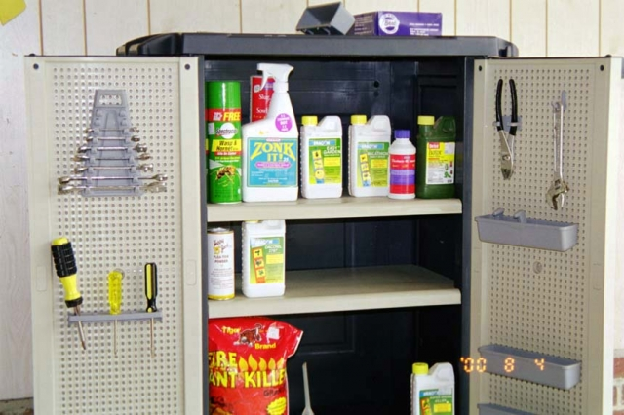
Proper storage can reduce risk of exposure.
Pesticide Storage
Notes:
Keep them in their original containers, with the label. What do we do if the label falls off? Keep track of what is in your storage area. If a label is fading or starting to fall off, go online and print a copy of the same product, formulation, and concentration, and tape it to the container with the wide clear packing tape. Do not put it in a soda or water bottle container. Do not assume you will remember what the product is a year from now, or even a month from now. We have too many other things on our minds!

Slide 42
Have a locked cabinet.

Slide 43
Store liquids below solids in case of spills or leaks.

Slide 44
Keep a list of pesticides in stock.

Slide 45
Reduce exposure by wearing appropriate clothing.
Notes:
How often do you see people applying pesticides without gloves?

Slide 46
Different parts of bodies absorb pesticides at different rates.

Slide 47
Activity: ID rates of absoprtion
1.3
1.6
2.1
3.7
4.2
5.4
11.8
1.0
Notes:
Hand out sheets to groups and have them try to arrange absorption rates, and agree on the rating. The forearm rate is given 1. Determine what part of the body absorbs at 1.3 times that rate, 1.6, 2.1, etc., with 11.8 being the highest rate of absorption.

Slide 48
Activity: ID rates of exposure
3.7
4.2
5.4
1.3
1.6
2.1
3.7
4.2
5.4
11.8
2.1
1.0
1.3
11.8
1.6
Notes:
Find out which each group rated as the highest absorption rate (11.8, groin area). This is why some labels require those mixing chemicals and working with concentrates to wear chemical-resistant aprons.

Slide 49
Reduce exposure by wearing proper clothing. Read the label.
Notes:
How do you know what is appropriate? READ THE LABEL.

Slide 50
Samples of gloves.
Notes:
Show leather, latex, dishwashing, chemical-resistant, nitrile, etc. and explain pros and cons of each.

Slide 51
Wear appropriate clothing.
Notes:
At the very least, regardless of the label, wear long sleeves, gloves, long pants, and footwear that will not absorb pesticides. NY Times 3/13/12 photo.

Slide 52
Wear appropriate clothing.
Notes:
At the very least, regardless of the label, wear long sleeves, gloves, long pants, and footwear that will not absorb pesticides.

Slide 53
Guard against and prepare for spills.
Notes:
Have a spill kit with a shovel, bags, gloves. This is what farmers would have on hand, and it’s something to think about for homes.

Slide 54
Kitty litter will absorb spills.
Notes:
Absorb liquid spills with kitty litter, wrap in plastic and put with solid waste. For solid spills, try to collect and reuse.
However, check the label first!

Slide 55
Wash yourself.
Notes:
After applying pesticides, wash up, especially before eating, drinking, smoking, or using the bathroom. This will decrease exposure. Remember that pesticides on your hands could be transferred to something else – forehead, steering wheel, door knobs!

Slide 56
Reduce exposure to your family through proper clean-up and laundering.
Notes:
Wash in hot water separate from other family clothing.

Slide 57
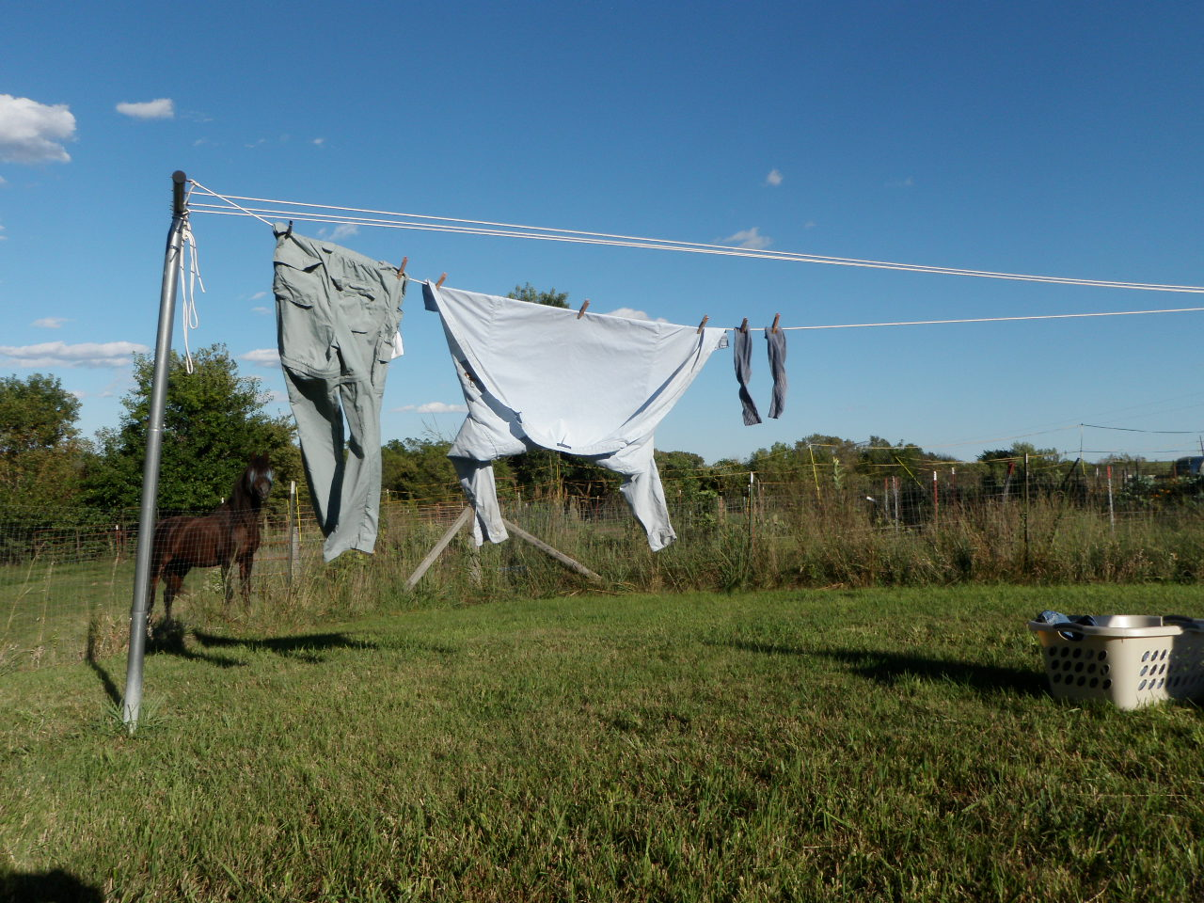
Dry on clothes line.
Notes:
Don’t put in the dryer. Drying on clothesline allows for any residues to evaporate off with water or be broken down by sunlight.

Slide 58
Toddler dies from drinking insecticide stored in garage.
Notes:
Father owned an aerial application business. Toddler was unsupervised in the garage. What happened and what’s the message?

