Slide 1
National Pollutant Discharge Elimination System (NPDES)
Presentation by : Tom Janousek, Pest Consulting Services, Omaha, NE
NPDES in effect on November 1, 2011

Slide 2
Nebraska Department of Environmental Quality
http://www.deq.state.ne.us/Publica.nsf/
pages/11-007
General Permit
Fact Sheet
Flow Chart

Slide 3
DEQ NPDES Flow Chart

Slide 8
Table 1: Waters are Considered Group III When:
1. State Resource Waters…..Title 117.

Slide 9
Definitions of State Resource Waters, found in Title 117, Chapter 3 - Antidegradation Clause:
002 State Resource Waters - Class A - These are surface waters, whether or not they are designated in these Standards, which constitute an outstanding State or National resource, such as waters within national or state parks, national forests or wildlife refuges, and waters of exceptional recreational or ecological significance. Waters which provide a unique habitat for federally designated endangered or threatened species and rivers designated under the Wild and Scenic Rivers Act are also included. The existing quality of these surface waters shall be maintained and protected.

Slide 10
Table 1: Waters are Considered Group III When:
1. State Resource Waters…..Title 117.
2. Listed as impaired… for any ingredients in pesticides residuals from application…

Slide 11
Table 1: Waters are Considered Group III When:
1. State Resource Waters…..Title 117.
2. Listed as impaired… for any ingredients in pesticides residuals from application…
3. Threatened or Endangered Species present……

Slide 12
http://outdoornebraska.ne.gov/ wildlife/programs/nongame/
Endangered_Threatened.asp
Nebraska Game and Parks Commission

Slide 13
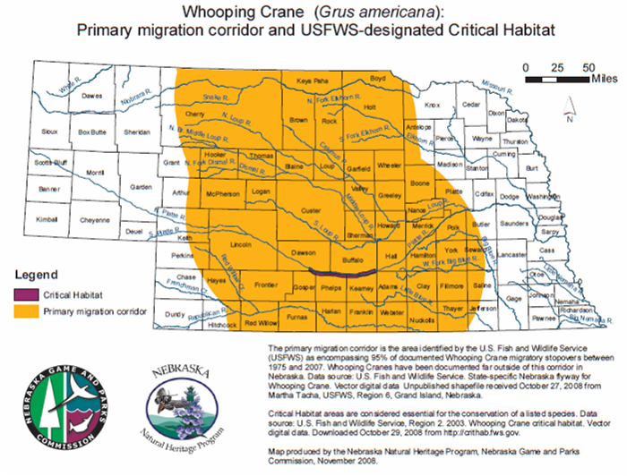

Slide 14
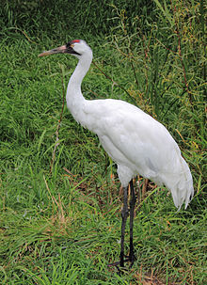
Nebraska Endangered or Threatened Species
Whooping Crane
5’ with 7’ wingspan
Nest in Canada
Raised nest in marsh
Omnivorous
Migrate through Nebraska in spring

Slide 15
Table 1: Waters are Considered Group III When:
1. State Resource Waters…..Title 117.
2. Listed as impaired… for any ingredients in pesticides residuals from application…
3. Threatened or Endangered Species present……
4. Application of pesticides to, over, or near water with 250’ of #1, #2, or #3 ……

Slide 16
Table 1: Waters are Considered Group III When:
1. State Resource Waters…..Title 117.
2. Listed as impaired… for any ingredients in pesticides residuals from application…
3. Threatened or Endangered Species present……
4. Application of pesticides to, over, or near water within 250’ of #1, #2, or #3 ……
5. Application of pesticides to, over, or near water within 250’ of surface intake for drinking water…

Slide 18
Notice of Intent (NOI) not required.
Follow Best Management Practices (BMP) listed in Tables 2 & 3.

Slide 20
Table 2
Best Management Practices (BMP) Plan:
  Identify ‘targets’
  Identify Endangered & Threatened
  Weather during and after
  Follow label
  Calibrate appropriate equipment
  Visual inspection
  Record keeping

Slide 21
Notice of Intent (NOI) Required.
Follow Best Management Practices (BMP)
listed in Tables 2 & 3.

Slide 22
Part 1.
D. Notice of Intent (NOI)
1. For Group III waters
a. A NOI is required for all Group III waters, except:
b. A NOI is not required for the application of pesticides to control flying insects or their larva including mosquitoes if the Group III waters are state resource waters See Part 1 B(1)(a)(i).

Slide 23
Additional Pesticide Use Management Plan (PUMP) Required. See Table 4

Slide 25
Pesticide Use Management Plan
BMP Implementation
Documentation of chemical characteristics
Copies of labels
Impact on waters, Endangered Species
Alternative methods
Maintaining records

Slide 26
Nebraska Department of Environmental Quality
http://www.deq.state.ne.us/Publica.nsf/
pages/11-007
General Permit
Fact Sheet
Flow Chart
Presentation by : Tom Janousek, Pest Consulting Services, Omaha, NE

